Slide 1
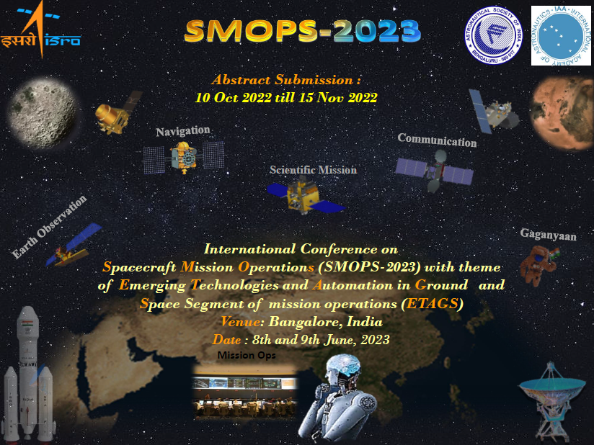

Slide 2
Introduction
ISTRAC/ISRO, ASI and IAA are collaborating to organize an International Conference on “Spacecraft Mission Operations (SMOPS)” with theme of “Emerging Technologies and Automation in Ground and Space Segment of mission operations (ETAGS)”. The first SMOPS conference is planned to be organized in Bangalore, India during June 08-09, 2023.
The objective of this unique conference is to associate and connect with the various space agencies, start-ups, industry and academia within and outside India. The conference aims to bring all space leaders together to share their views on existing technologies and its challenges, while previewing the state of the art technologies that are being conceived globally to make space mission operations more secure and robust. This conference will also provide a unique platform to boost the synergy between academia, industry and other space agencies.
For further details, visit : https://smops2023.istrac.gov.in ;
For Abstract submission ,visit : https://iaaspace.org/event/international-conference-on-spacecraft-mission-operations-smops-2023/#about

